Slide 1
S1P
LNs
M2 MΦ
MSC
S1P₁
Pericyte
?
Th1
Capillaries
S1P
Tumor vessel normalization
Arteries
N-cadherin
S1P₁
SMC
EC
(anti-proliferative)
RGS5^{-/-} mice
RGS5 (-)
anti-stenotic ECs
RGS5
ROS
Aging
S1P₁
SMC
N-cadherin
EC
(pro-proliferative)
RGS5 (++)
pro-stenotic ECs
Figure 1. Regulation of mural cell behaviors in capillaries and larger arteries
RGS5 deficiency (Hamzah J et al., 2008) and the presence of Th1 cells (Tian L at al., 2017) induce tumor vessel normalization by promoting pericyte coverage on capillaries. RGS5, which converts healthy anti-stenotic ECs into generative pro-stenotic ECs (Nishio et al., 2015b), hinders S1P1-dependent signals and disturbs localization of N-cadherin (Nakahara et al., 2015). During embryogenesis, S1P1-dependent signals play indispensable roles in forming EC-pericyte interactions via N-cadherin (Paik JH et al., 2004). S1P1-dependent signals reportedly induce T cell egress from lymph nodes (Chiba K et al., 2006). Some pericytes in the brain are derived from M2 macrophages (Yamamoto S et al., 2017). There is a controversy regarding the relationship between pericytes and mesenchymal stem cells (MSCs) (Crisan M et al., 2008; Guimarães-Camboa N et al., 2017)

Slide 2
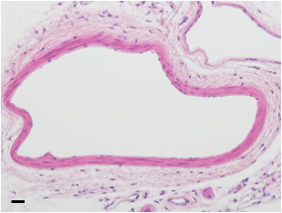
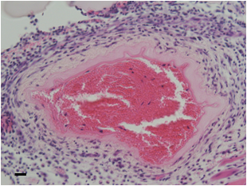
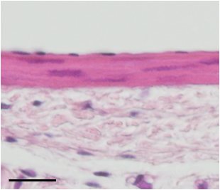
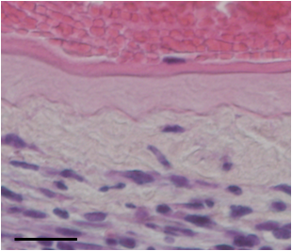
Non-operated
Wire Injury (WI)
Tm
Tm
*
Figure 2. Wire injury operation induces disappearance of cellular components in tunica media in SCID mice.
SCID mice, which lack functional T cells and B cells, were subjected to wire injury (WI) operation in the femoral artery. After one week, mice were sacrificed and histology of the femoral artery was examined by hematoxylin and eosin (HE) staining. WI operation induced disappearance of cellular components in tunica media (Tm), which showed amorphous structures as indicated by an arrow in the lower right panel. Around the WI-operated arteries, spindle-shaped cells were massively infiltrated as indicated by an asterisk in the lower right panel. Scale = 20 μm

Slide 3
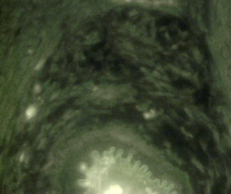
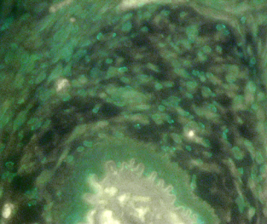
control IgG
anti-SMA antibody
Figure 3. Wire injury operation induces massive escape of smooth muscle cells to extravascular spaces in SCID mice.
Femoral arteries of SCID mice that received WI operation one week before was subjected to immunostaining studies using an anti-smooth muscle actin (SMA) antibody. The cells distributed in the extravascular space of the operated artery were positively stained by anti-SMA antibody. Scale = 20 μm

Slide 4
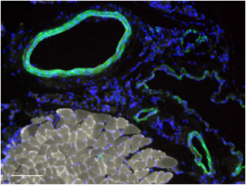
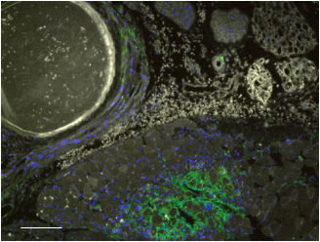
Non-operated
Wire injury (WI)
Figure 4. Wire injury operation induces disappearance of smooth muscle cells from tunica media in nude mice.
Nude mice were subjected to wire injury (WI) operation in the femoral artery. After one week, mice were sacrificed and histology of the femoral artery was examined by immunostaining studies using an anti-smooth muscle actin (SMA) antibody. Similar to the case of SCID mice, smooth muscle cells (SMCs) were lost from tunica media (right) but only a small population of SMA-positive cells were detected in the extravascular spaces (arrows in right panel). Interestingly, a number of SMA-positive cells were accumulated within skeletal muscle tissues (arrowheads in right panel) and adipose tissues (data not shown). SMA-positive cells were negative for F4/80, a macrophage marker, CD56, an NK cell marker, CD19, a B cell marker, Pax7, a satellite cell marker, Myf5, a myoblast marker (data not shown). Autofluorescence signals from hemoglobin in erythrocytes and myoglobin in skeletal muscle cells were decolorized according to the method described previously (Nishio et al., 2015a). Scale = 100 μm

Slide 5
T cells
MEMTES
Vascular injuries
(removal of ECs)
ECs
SMCs
Aneurysms ??
fibroblasts
Figure 5. Model for T-cell-mediated prevention of mural cells loss from vascular walls
WI-operated arteries, whose ECs were mechanically removed, undergo a massive escape of mural cells toward extravascular spaces (MEMTES) under T cell-deficient conditions as observed in SCID and nude mice (Nishio et al., 2015b). The histology of those MEMTES arteries resembles the pathology of aneurysms of non-atherosclerotic basis such as aneurysms on the circle of Willis. Whether CD4⁺ T cells or CD8⁺ T cells as well as whether a specific clone of T cells or a broad spectrum of T cells are involved in prevention of MEMTES is a matter to be elucidated.

Slide 6
Aneurysms and stenosis on coronary arteries
Kawasaki Disease
z
Retinal microaneurysms
Diabetic retinopathy
Takayasu disease ?
Aneurysms on the circle of Willis
Figure 6. The occurrence of non-atherosclerotic aneurysms and stenosis.
There seems to be a tendency that aneurysms that are not based on atherosclerosis (non-atherosclerotic aneurysms; NAA) occur in specific sites in the body. For example, arteries in the central nervous system (CNS) such as retinal microvessels and arteries on the circle of Willis are the major sites for NAA. Since T cell population in CNS is considerably small, it might be possible that MEMTES could not be sufficiently prevented under vascular injuries. In Kawasaki disease, coronary arteries are affected by NAA by unknown reasons.

